Slide 1

WELCOME to NETFLIX Movies and TV Shows!!
Thank you for visiting my project
Please kindly use Slide Show or press F5 for better visualization
Hope you enjoy!

Slide 2

Movies and TV Show
Project by Louisa Veronica

Slide 3

Business Understanding
Business Benefit
Result Summary
Streaming service that offer movies and TV shows based on paid subscription
Create recommendation system that ease user to find movies and TV shows to be watched
Netflix has more movies than TV shows
Most movie’s genre is dramas, international film under TV-MA rating and having around 90 mins duration
Most TV shows’ genre is Kids TV , however, rating is under TV-MA, and mostly having only 1 season

Slide 4

Data Source:
https://www.kaggle.com/datasets/shivamb/netflix-shows
Data Detail:
show_id: ID of each show
type: show category, whether movies or TV show
title: movies or TV shows’ title
director: movies or TV shows’ director
cast: movies or TV shows’ actor or actress
country: country where movies or TV shows are produced
date_added: date movies or TV shows added to Netflix
release_year: movies or TV shows’ actual release year
rating: movies or TV shows’ rating
duration: movies or TV shows’ duration, whether in minutes or season(s)
listed_in: movies or TV shows’ genre
description: movies or TV shows’ description

Slide 5


Slide 6

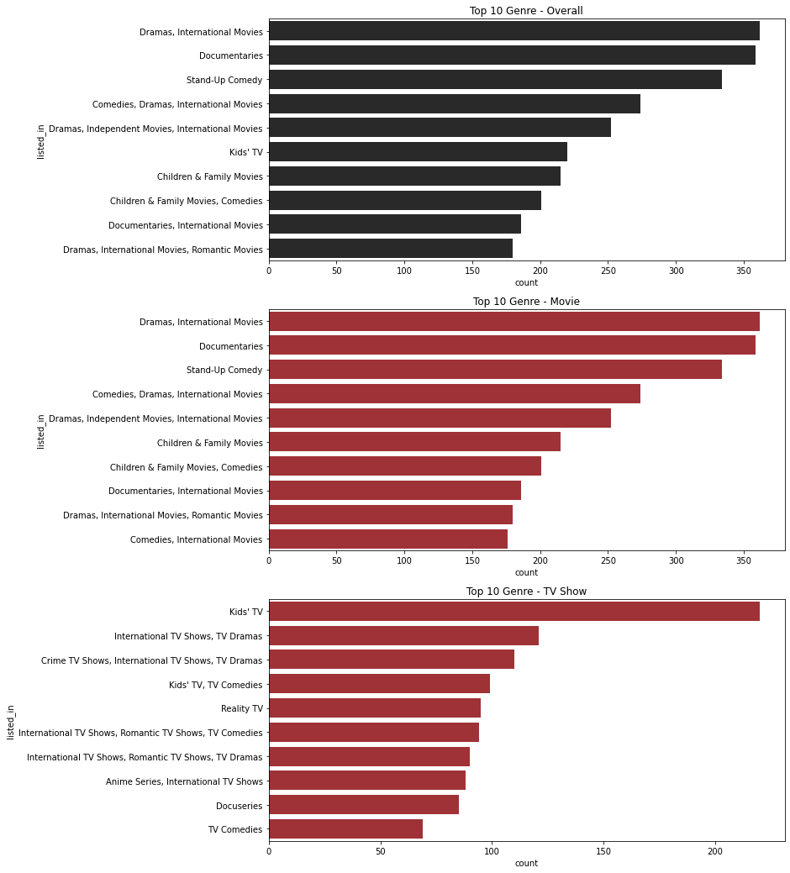
GENRE

Slide 7
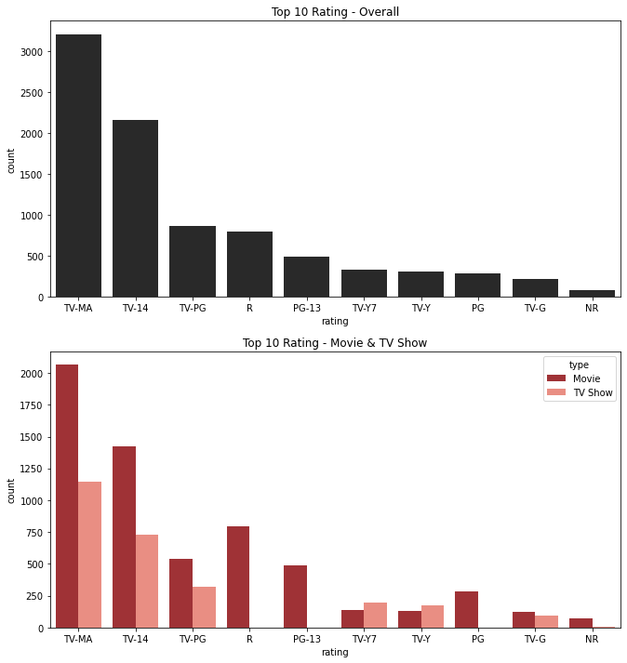
RATING

Slide 8
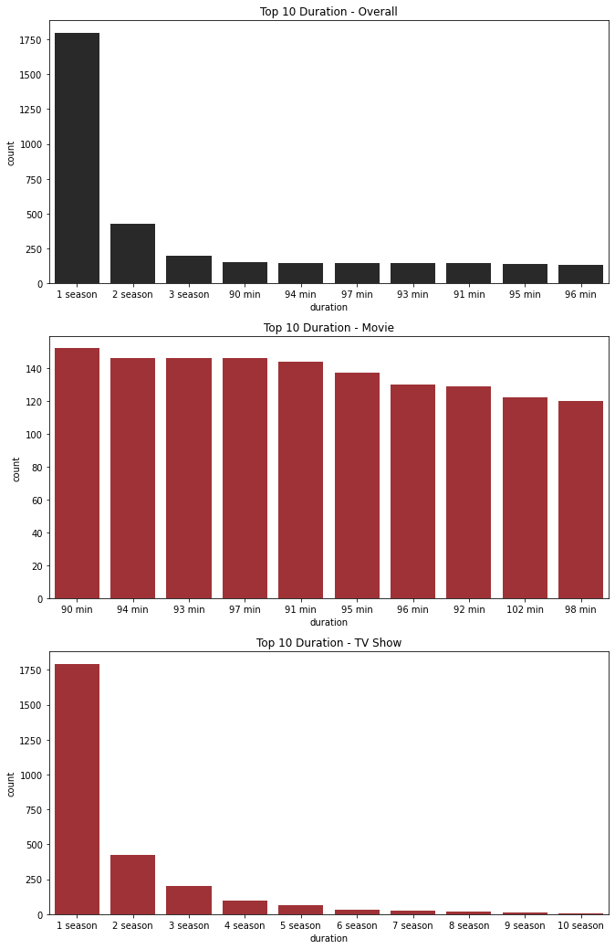
DURATION

Slide 9

Netflix has a lot of movies and TV shows:
6131 movies
2676 TV shows

Slide 10



TOO MANY MOVIES AND TV SHOWS, WHAT TO WATCH???
Don’t worry, Click below!

Slide 11
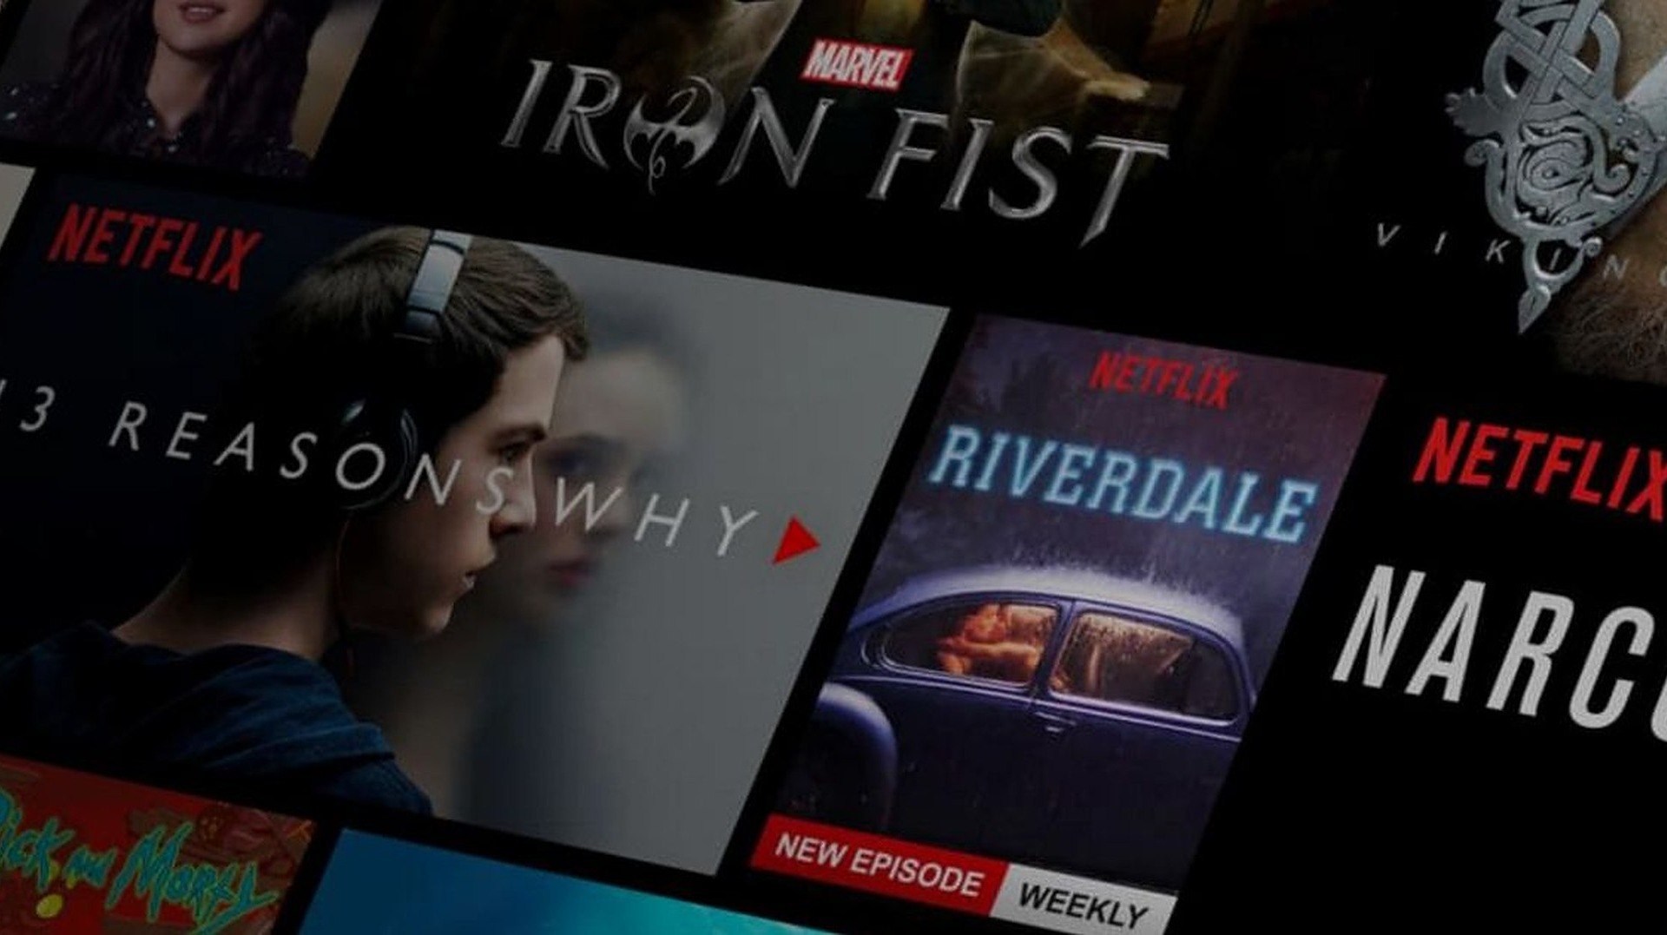

Creating a recommendation system that will suggest other movies or TV shows titles based on inputted title
Insert Movies or TV Shows Title Here

Slide 12



Insert Movies or TV Shows Title Here
Search

Slide 13





Search
Naruto

Slide 14

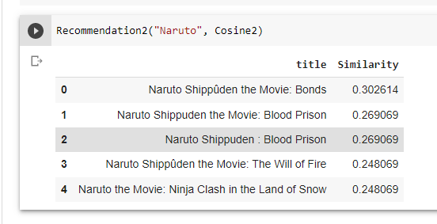
Model Result
Best recommendation system is created by using Count Vector to process director, cast, listed-in(genre), and description column and calculate Cosine Similarity

Slide 15
Conclusion
Netflix has more movies than TV shows
Most movie’s genre is dramas, international film under TV-MA rating and having around 90 mins duration
Most TV shows’ genre is Kids TV , however, rating is under TV-MA, and mostly having only 1 season
Adding more feature to the recommendation system give more accurate result

Slide 16
Suggestion
Create recommendation system by using:
other feature as input (director, cast, etc)
other method (NLTK or clustering, etc)
other dataset to be combined with this dataset (guest preference, shows score, etc)

Slide 17

Link to project:
https://github.com/LouVe92/Netflix-Movies-and-TV-Shows-Analysis
Model Result
THANK YOU
LinkedIn: https://www.linkedin.com/in/louisa-veronica

